Slide 1
A3 Project Proposal Sections
Context of Problem, Purpose of Project, Personal Inspiration or Rationale
Project Aim or Design Brief
Project Specifications or Design Criteria
Initial Research
Initial Ideas or Equipment, Components or Software
Next Steps or Project Planning
Include any references and sources of information.

Slide 2
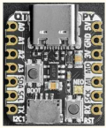
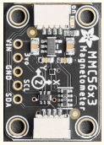
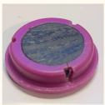



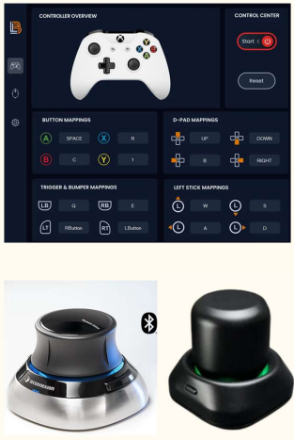

3DBind CAD Controller by Chiron H
Problem and Inspiration
Design Brief and Criteria
Personal Skills and Areas to develop
I have always found learning different key bindings hard, especially for CAD software as they are not intuitive at all. In addition, keyboards pose difficulties for some SEND users.
I recently learned about software which allows you to map a game controller to specific keys on a keyboard to make PC gaming easier. This inspired me to make a device that replaces the need for a keyboard while using 3D CAD (Computer Aided Design).
Design, build and code an affordable controller to make 3D modelling in Autodesk Fusion more intuitive (remove key bindings) and accessible to all by:
replacing need for a keyboard
making it a fully open-source home build kit
It should be able to pan around the 3D model in all directions and zoom both in and out of the model
It must be affordable by using fewer parts.
It should use simple construction with minimal specialist components & tools.
It should be sustainable by being made from reusable or recyclable materials.
Programming and CAD
Iterative design process
Planning and preparation
Analytical and logical approach
Reflections and evaluation
Components and Software
Initial Research
Adafruit QT Py RP2040 - Compact and affordable yet powerful microcontroller, great for prototypes, as well as more advanced projects. It’s easy to source and even has an onboard LED. It can be easily re-used for future projects.
Adafruit MMC5603 - Small magnetometer which will detect the movement of the magnet that will be placed in 3Dbind’s handle. This can be directly connected to a microcontroller. It is also affordable, easily sourced and can be re-used.
Kitchen magnet - This will be placed inside the handle, the magnetometer will pick up its magnetic field and detect if it moves.
I researched similar products online and came across ‘SpaceMouse’ made by
3Dconnexion which was developed for professional designers to more ergonomically
navigate 3D spaces. This product is very expensive.
While looking for more information, I found some open-source projects made to replicate
the ‘SpaceMouse’ and these enabled me to learn about the inner workings. Unfortunately,
these replica products require specialist components and tools such as heated inserts, as
well as the need to use a soldering iron.
STEMMA QT Cable - An easy way to connect the microcontroller and magnetometer together without the need for soldering.
Extension and compression springs – These will support the handle and keep it in position.
CircuitPython for coding the magnetometer calibration program, checking the electronic components work and for writing the program to control my CAD software instead of using key bindings.
Autodesk Fusion to design my 3Dbind model and use for 3D printing prototypes to test, analyze and improve.
Project Planning
Physical Design, Build and Test
Initial CAD models of 3D bind casing, base unit and handle.
3D print first prototype and test against criteria. Edit and print adapted prototype.
Continued development to final 3D print and assembly of components.
User instructions developed
Costing of final programmed controller.
Programming
Code calibration programme for magnetometer.
Code Microcontroller (MC) programme to interpret magnet direction.
Test code, evaluate errors and debug programmes.
Final prototype evaluated against criteria and tested with target market.
References:
https://www.autodesk.com/shortcuts/fusion-360
https://3dconnexion.com/uk/spacemouse/
https://www.youtube.com/watch?v=iHBgNGnTiK4
Notes:
Creativity – 0-8 marks
Communication – 0-6 marks
Technical Knowledge 0 -6 marks
Creativity – 7 – top end of excellent, misses out on ‘exceptional’ as it’s not super unique, it’s more of an innovation and alternative use for an existing idea
Communication – 6 – excellent presentation, really well communicated, looks professional, isn’t cluttered with info but provides a good level of detail
Technical knowledge – 5 – just missing more detail on potential challenges

Slide 3
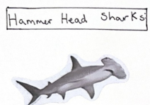
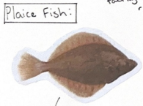
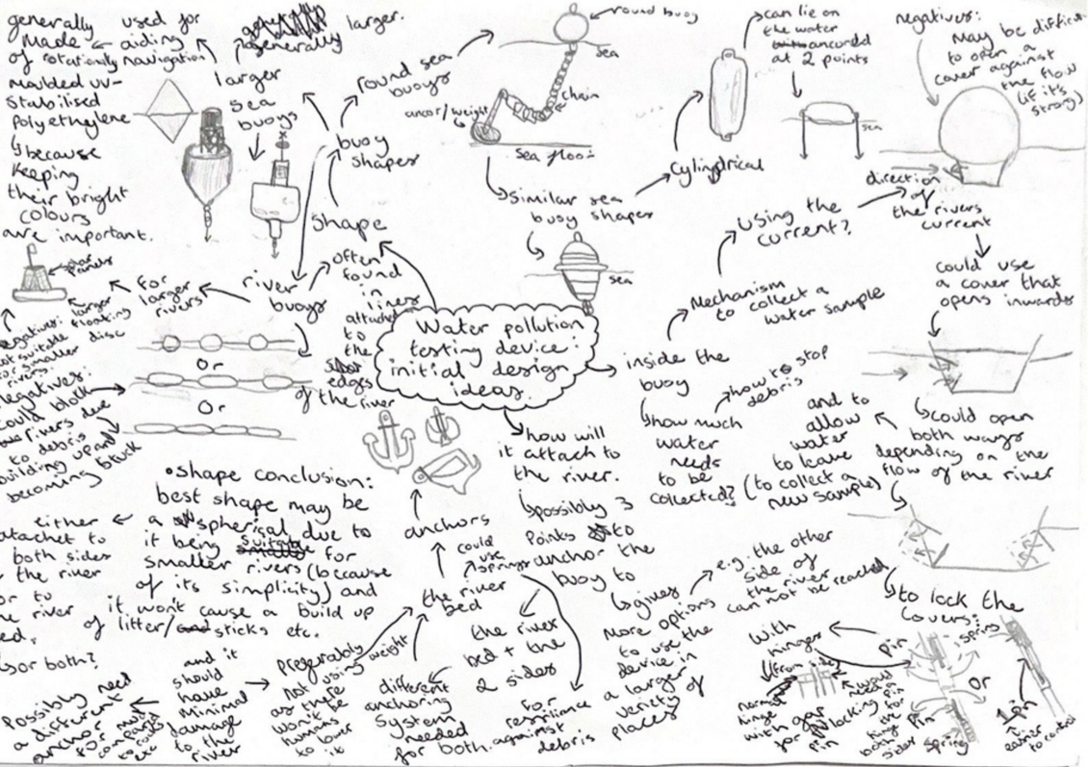
Remote Water Testing Device
By Mari P
Aim and Purpose
Design Criteria
Initial Research
Inspired by my work experience placement (at NRW), the device aims to make monitoring of less accessible waterways and alerting of environmental problems safer and more remote. The project focuses on the anchoring and housing of testing equipment in a moving body of water or hostile environment.
The device should be waterproof.
It must be easy to dispatch into the stream/river/lake/sea.
It must be easy to retrieve.
It must be static in the body of water.
The anchoring mechanism must not get entangled.
It should use a small volume of water with minimum debris/mud in.
Natural Resources Wales website has maps that update based on water quality in different areas: https://environment.data.gov.uk/wales/bathing-waters/profiles/index.html
The device I am developing will ensure that these maps can be as up-to-date as possible and support allocation of environmental improvement projects.
Biomimicry inspiration:
Initial Ideas
Next Steps
Further biomimicry research and design sketches for anchoring mechanism
Hydrodynamic force calculations to stress test different anchor design shapes
Main housing design and further anchor mechanism development
Anchor mechanism CAD designs (using AutoCAD)
Evaluations to be made at each stage of development against design criteria.
Prototypes built and analysed. Further developments identified.
Potential Challenges
Developing sufficient CAD skills to ensure anchor designs fulfill criteria
Prototypes for testing – 3D printing and other physical builds can be cost and time intensive
Notes:
Creativity – 7
Communication – 4
Technical knowledge - 5

Slide 4
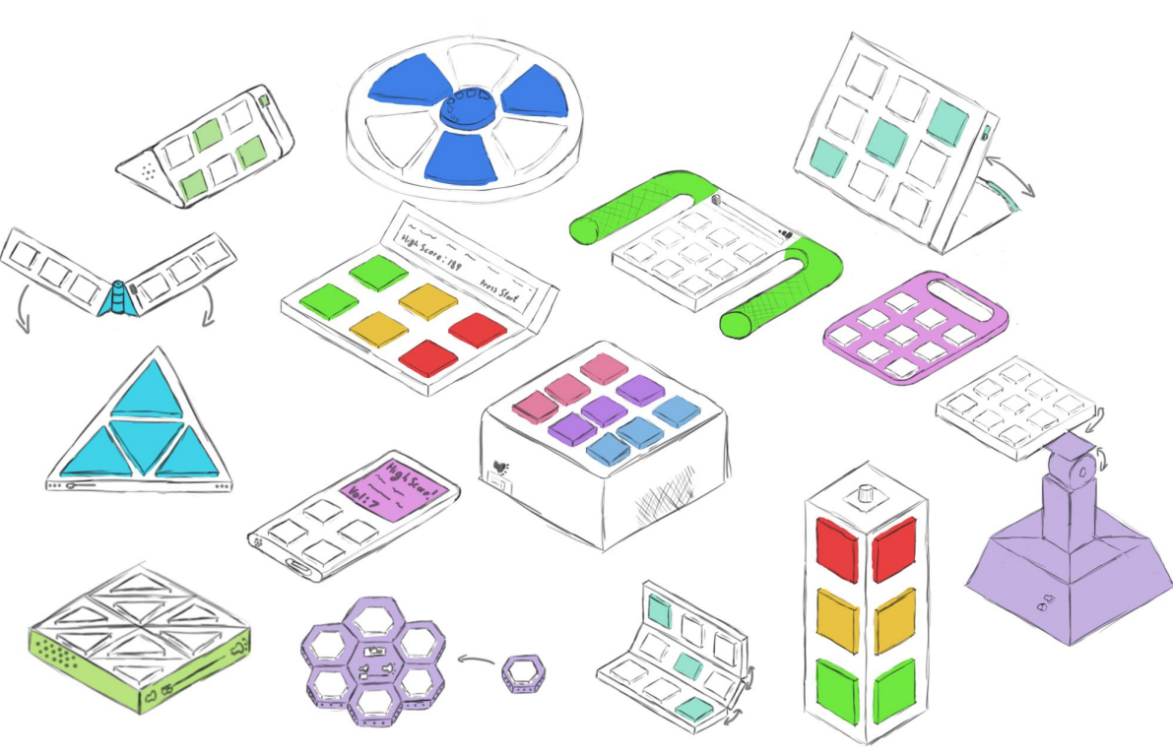
My product aims to improve the attention span of those with ADHD, a disorder that many of my friends have, without taking pills such as Adderall which can cause suppression of emotion; using backlit buttons and a combination of a sequence memory game, hand eye coordination game.
Sequence Memory Toy Project
By William S
Initial Research & Rationale
Initial Ideas & Factual Evidence
I have researched topics including fitness, entertainment, mental health and sleep to summarize potential problems to solve.
Sleep
Irritations such as sound or light can cause deep sleep to be interrupted
Exposure to blue light before bed can wake the body up, increasing time taken to sleep
Warmer rooms make it harder for the body to fall asleep
Dark and cold rooms make it hard for the body to wake up after sleep
Training reaction time over a 3-month period showed an average improvement of 20%.
Fitness
Lighter dumbbells are often wasted and thrown away after heavier ones are bought
Busier individuals don’t have time to commit to the gym
Gyms do not allow under 16s to enter
Home gyms are very expensive
Weights are impractical to transport
80% of people who frequently do working memory training experience a 30% reduction in inattentiveness.
While the average reaction time is 250ms, training can be reduced by as much as 40%.
Mental Health
Prolonged device usage daily can cause overstimulation
Daily meditation is hard to maintain without reminders
Hand-eye coordination and reaction time can be inconvenient and hazardous to train indoors
Memory can be difficult to improve without tablets
85% of people who frequently do working memory training experience a 33% increase in working memory performance
Entertainment
Devices, games & shows are often expensive or require memberships to be accessed
When used in public, screens and sound can bother or be a danger to others
Fidget Toys are often loud and bother others
Short form content causes decreased attention span
Next steps
Create “time-out" looping code that cuts power to battery after 5 minutes of inactivity
In conclusion, I have decided to research further into the training of Memory, Reaction time and Hand-eye coordination – I have chosen these topics as the importance of training general mental function is understated relative to that of studies and work. General mental function tends to decrease with age and so it is important to train it frequently instead of taking pills which may have adverse side effects. These topics closely relate to each other and I believe can be incorporated into one device to train all three aspects in a fun and efficient manner.
Develop 3 ideas further and evaluate again specification
Create final CAD model of device with accurate dimensions
Sources
Planning and time constraints to achieve different elements of project
How to manufacture
Testing with a user focus
Create electronic prototype and test with user
Important Considerations
https://Alzheimer.ca/en/about-dementia/do-i-have-dementia/differences-vetween-normal-aging-dementia
https://thesportsedu.com/reaction-time-definition
https://www.pscychologytoday.com/gb/blog/the-athletes-way/201311/hand-eye-coordination-improves-cognitive-and-social-skills
Set specifications for developing ideas against
Finalise design to take forward based on analysis
Make 1:1 physical aesthetic prototype of device and fit components
Evaluation and identify further development opportunities
Notes:
Creativity – 7
Communication – 6
Technical knowledge - 3

Slide 5
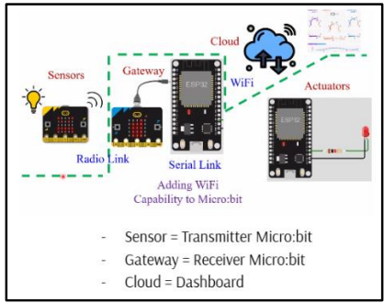
IoT Smart Home System
By Ananyaa R
Context
Many people with life-limiting conditions such as Dementia and Alzheimer's struggle with remembering daily tasks, in severe cases even starting to forget important people in their life. Many people live in Hospice care due to the severity of these complications, receiving care from trained workers. A study conducted by UCSF showed that 48% of caregivers or family members of hospice-enrolled dementia patients experienced dissatisfaction with the care. Hence why, for this large group of people, I wanted to try to produce a prototype that can make daily life easier for them, while increasing their quality of life. Although it was initially difficult to come up with solutions, if there is anything I love more than engineering, it is problem solving.
Aims and Areas of Focus
My project has many parts, but essentially, it aims to take different readings of different factors in different environments, and then transfer the results into a user-friendly interface, which is able to send alert signs for anomalous results, hence enabling me to code a food inventory system.
I aim to utilize Micro:Bits to code an Internet of Things (IoT) smart home system, although an Arduino Uno or a Raspberry Pi could also be used.
The specific parts I have decided to focus on are:
- General base code walkthrough
- A smart light system
- An autonomous plant watering system
- A food inventory monitoring system
- Evaluations and Conclusions
Who is this product for?
As mentioned briefly above, this product is for patients struggling with Dementia, Alzheimer’s, Depression, Severe Anxiety and in general poor health due to medical conditions. However, it is important to note that the target audience for this product is not exhaustive, although, while making/designing this product, I had certain groups in mind.
The 5 W’s
How will it be used?
As this will just be a prototype, I will focus more on the functionality aspect than anything else. However, in future iterations it should be possible to use more than two Micro: Bits to add on different functions. The code should be very versatile.
Where will it be used?
This could belong both in houses of the target market and in Hospice Centres to make things easier for the hardworking staff.
When and why will it be used?
It can be used whenever required, but I would recommend always using it for constant reminders, especially for people who need more reminders. Some possibilities can end in annoyance otherwise – e.g. if a patient forgets that the milk is finished and the shops are already closed, or if a patient forgets to water a plant and it starts to wilt.
What will it be used for?
It will be used to either remind people to carry out daily tasks that they often forget to do or do tasks for them. For example, in the smart light system, it is possible for the lights to turn off all by themselves or for the plant watering system, water plants automatically at certain times of the day.
Equipment & Software to be used
Two Micro:bits - one to be a transmitter and the other to be a receiver.
Microsoft MakeCode as the interface to code the Micro:bits (Block-based and Python programming to improve my understanding of code).
Adafruit IO Cloud-based dashboard to interact with the Micro:bit data.
Email account for notifications to be received.
How will everything connect?
Tasks to complete
Program temperature and light sensor limits and trigger notification email
Create explanation videos of the food inventory system to show how code works.
Program general base code for transmitter and receiver
Set up Adafruit dashboard and link to transmitter and receiver Micro:bits to respond to data
Test programming using food inventory system.
Design smart light and plant watering systems that use base code program.
Evaluate project and identify further areas for development

Slide 6

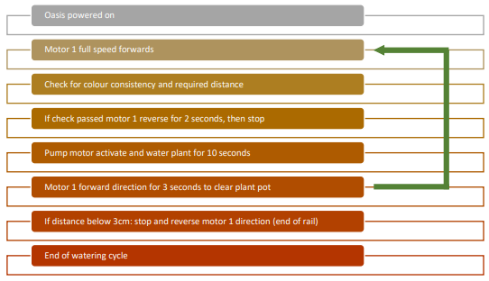
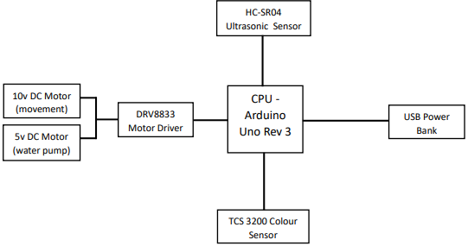
1 // Overview
Oasis is a robot based on a modular solution through which it waters plants. Its main aim is to reduce water wastage and promote sustainability in the home as well as outdoors.
It will use sensors to detect plant pots.
It will have a pump system to water the plant.
It will be versatile by being comprised of various modules which can be altered or changed based on the needs of a user, making it an efficient and adaptable solution for any scenario.
A Plant Watering System
by Michal W
2 // Components and Software Ideas
I will use two different sensors, along with DC motors and other components to manage the entire setup. They will be connected using jumper wires to the main Arduino Board on the carriage. I have included a circuit diagram.
Programming Algorithm
To create a functional system and watering cycle for Oasis, I will use the programming language C.
I will use functions such as Pulse Width Modulation for controlling the speed of motors and implement the plant pot detection algorithm utilising consistent distance and colour value setting.
Also, I will have to write functions for carriage direction reversal at the end of the rail or for stopping at a pot.
Electronic Components
3 // Project Planning
I used a Gantt chart to plan the project. Each of the 12 periods represent half a week, so the duration should be 6 weeks.
4 // Key Considerations
Constructing an efficient movement system
Ensuring water is contained during the movement and does not leak on electronic components
Aligning the watering arm to different user conditions
Creating accurate CAD models so parts fit effectively together once 3D printed
Costings of materials and assembly for production
PLANNED START
PLANNED DURATION
ACTUAL START
ACTUAL DURATION
PERCENT COMPLETE
½ WEEK
ACTIVITY
1
2
3
4
5
6
7
8
9
10
11
12
Ideation
1
2
Research
2
2
Original design
3
2
Resource purchase
3
2
Carriage
4
2
5 // Personal Skills to Develop
Water flow system
4
3
Planning and time management to stay on track for project competition, especially with electronic, CAD and programming elements.
Attention to detail for accuracy in CAD designs, especially when 3D printing parts, which can be time and cost intensive if tolerances are incorrect.
Movement system
4
4
Base station
8
2
Sensor testing
8
1
Programming
8
3
Final testing
11
2

