Slide 1
Arkwright Engineering Scholarships
Launch Webinar
Wednesday 9th September 2026

Slide 2
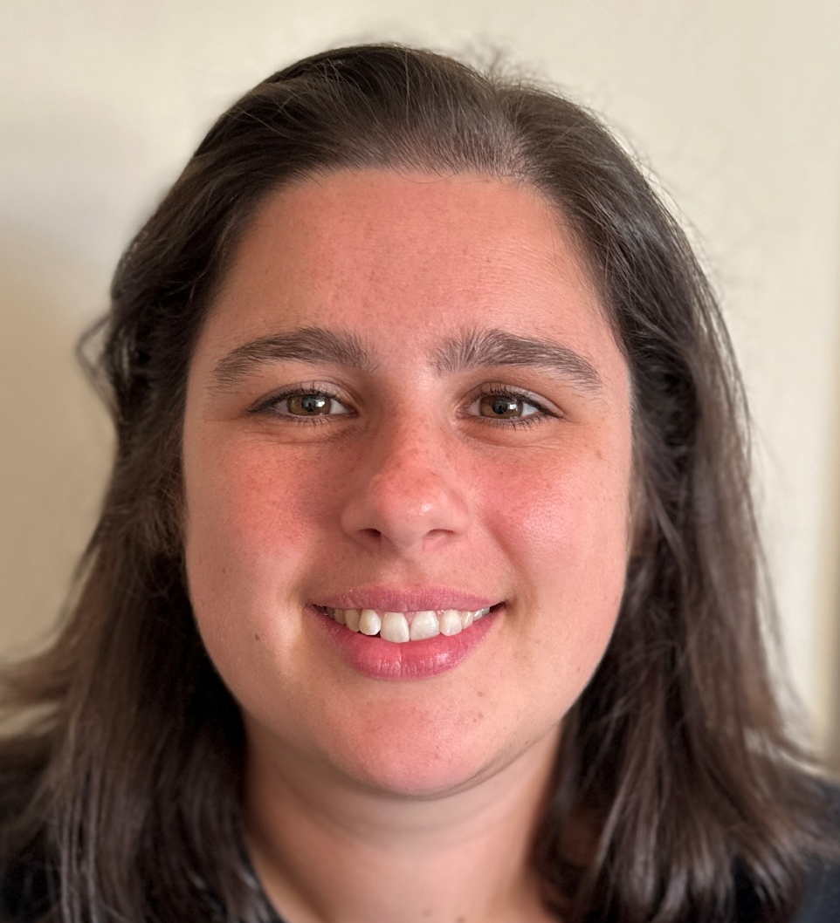
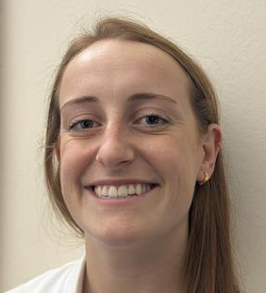


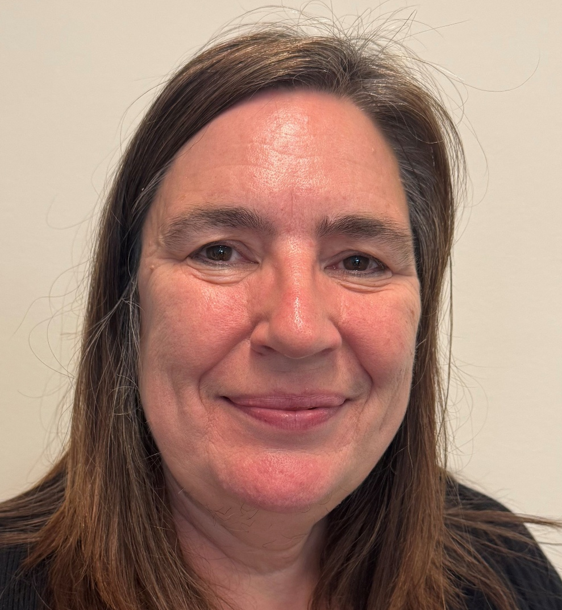
Meet the team
Hayleigh McAleese
Scholarship Liaison Expert
Georgia Blenkinsop
Events Specialist
Chloe Fensome
Arkwright Scholarships Manager
Rachel Jenkinson
Programme Manager
(Events & Scholarships)
Claire Thorpe
Scholarships Administrator

Slide 3
Contact us
Via email using scholarships@smallpeicetrust.org.uk
Via phone on
01926 333200 (Option 3)

Slide 4
Session overview
Introduction to the Scholarship and Benefits
Current Scholars & Alumni Panel
Application Process
Q&A Session
Key Dates
Supporting Resources

Slide 5
Introduction to the Scholarship and Benefits
Hayleigh McAleese

Slide 6
Arkwright Engineering Scholarships
Established in 1991 and merged with The Smallpeice Trust in 2018
Operating across the UK, Channel Islands and Isle of Man
Our mission:
Inspire the young people of today to become the changemakers of tomorrow
Our focus:
High-potential young people aged 16-18 years old who want to progress into an engineering-related higher apprenticeship or university course

Slide 7
What is the Arkwright Engineering Scholarship?
Two years of support and guidance throughout your last two years in School/College
Key benefits:
  Connect days with industry and universities
  Mentoring by professionals
  Access to online resources
  Networking with other Arkwright Scholars
  Financial award

Slide 8
Key benefits
Smallpeice Virtual Scholarship
Externally Sponsored Scholarship
Attend welcome networking event
(virtual)
(in-person)
1 to 1 Mentor
Access to Group Mentor
In person Connect Days
Virtual Connect Days
Access to online enrichment resources and events
Networking opportunities with other Scholars
Scholar financial award - £250 per year
£150 per Scholar for state schools & youth organisations (year 1 only)

Slide 9
Long-term benefits
Recognised as a prestigious achievement by Universities across the UK, so looks fantastic on UCAS applications
Alumni activities including job opportunities with our Sponsors​
Powerful Alumni group (Almost 7,000)​

Slide 10
Longer-term benefits
Once you are in a career – further personal development opportunities…​
Become an Arkwright Mentor – providing invaluable first-hand knowledge, support and inspiration to our Scholars throughout their two-year Scholarship
​Help with the Arkwright selection process as an Interviewer

Slide 11
Institution benefits
Financial Support (in year 1 for state schools and youth organisations only)​
​
Winning prestigious Arkwright Engineering Scholarships helps to:​
motivate & reward high-potential students as they enter the 6th Form​
raise the supporting department’s profile within the institution
raise the whole institution's profile nationally​
provides the institution with valuable marketing opportunities to prospective parents​

Slide 12
Current Scholar & Alumni Panel
Chloe Fensome

Slide 13
Zara
Year 2 Arkwright Scholar

Slide 14
Sofia
Arkwright Alumni

Slide 15
Oscar
Year 2 Arkwright Scholar

Slide 16
Chrysi
Arkwright Alumni

Slide 17
Application Process
Hayleigh McAleese

Slide 18

















































Application Criteria
Current year group
Current study
Northern Ireland
Year 12
Scotland
S4
GCSEs
Engineering related
BTECs Level 2
Sciences
Design Technology
Computer Science
Scottish National 5s
IB Middle Years Programme
England & Wales
Year 11
Future study
Future career
A Levels
BTECs Level 3 or T Levels
Scottish Highers
Biomedical
Software
Civil
Electrical
IB Diploma
Engineering focused higher apprenticeship or university course
Chemical
Mechanical
Material
Energy
+ more

Slide 19
























Part 1
About You
About Your Parents/ Guardians
Part 6
Personal information and contact details
Contact details
Part 5
Engineering Interests
Current and Future Studies
Part 2
Stage 1: Application Form
Current subjects and subjects to study next year
Details of hobbies or projects linked to STEM
Part 3
An A3 overview of a STEM project to complete
The Arkwright Scholarship and Beyond School and College
A STEM Project Proposal
Written responses to questions about Arkwright and future career
Part 4

Slide 20
Part 4 – A STEM project proposal
What we expect to see:
  An idea for a project that you will be working on
    Finished or with enough progress to talk about during interviews in March/April
  1 side of A3 with font size 10 pt or above
  Digital submission
    Can include sketches but submitted in a digital format
    Set up your document in A3 format (PowerPoint/Word/another design software)

Slide 21

A STEM project proposal

Slide 22
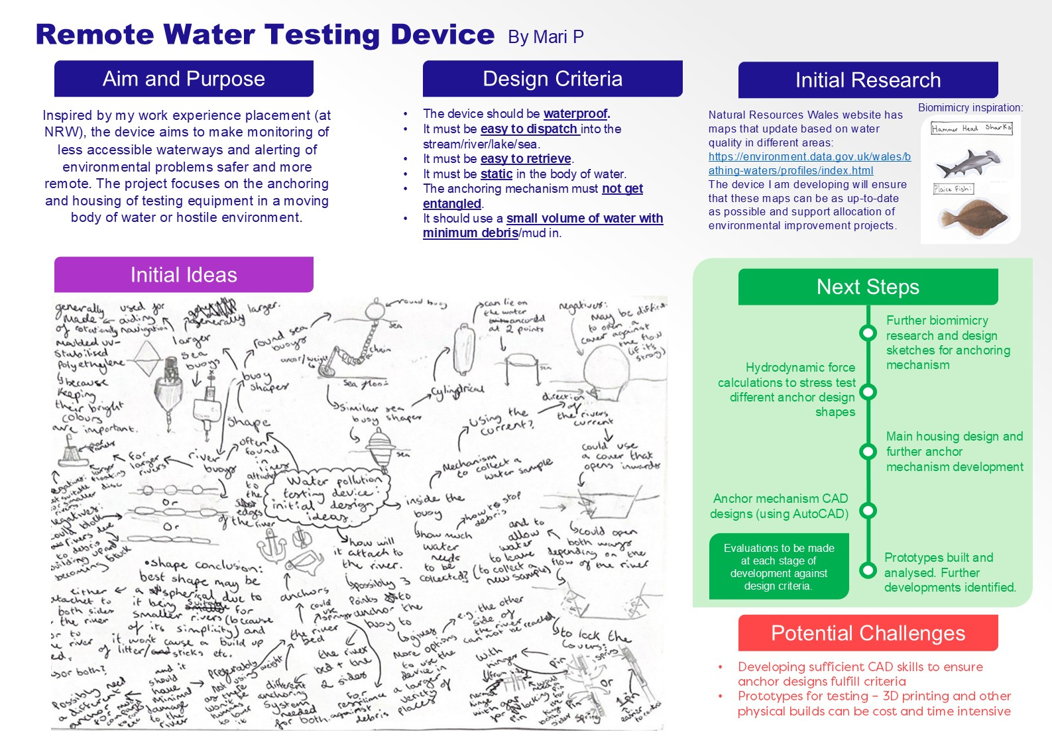
A STEM project proposal

Slide 23
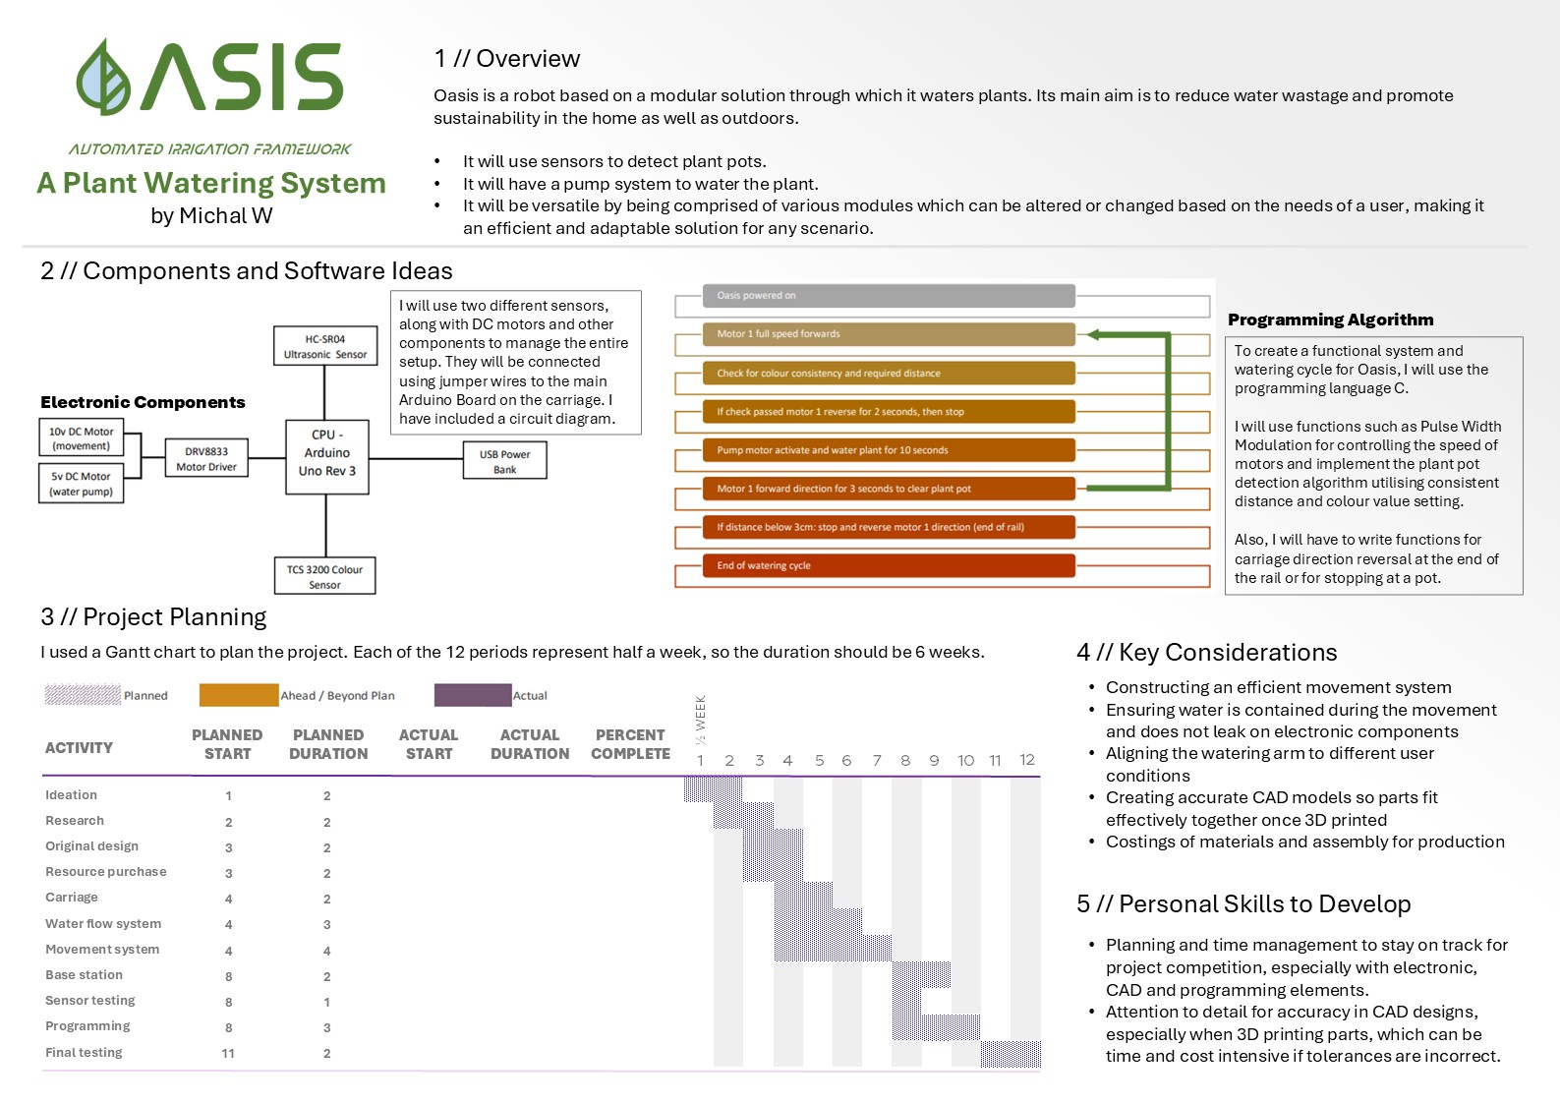
A STEM project proposal

Slide 24
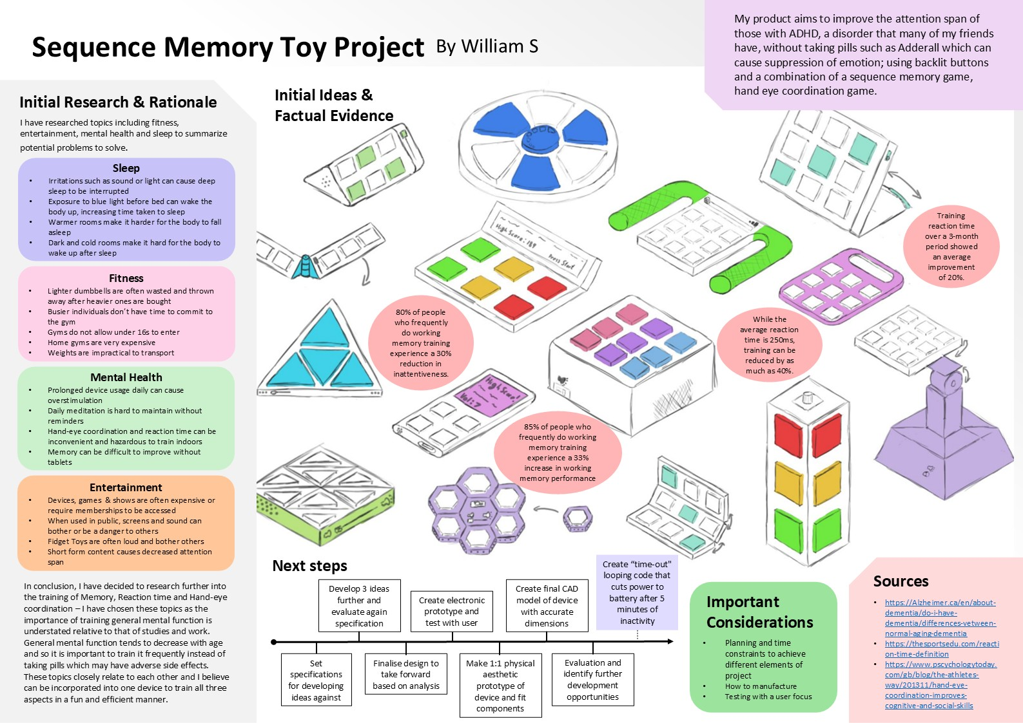
A STEM project proposal

Slide 25

















Quiet, private room free from distractions
Compatible device
Stage 2: Online Assessment
Ability to take and upload images
Camera and microphone

Slide 26
Structure of the assessment
Section 1
Section 2
questions to choose from
modules
Open-ended design question exploring an Engineering problem
Numerical Mechanical Spatial
Use blank pieces of paper and a pen and/or pencil to answer the questions
Multiple choice

Slide 27

















Virtually on Microsoft Teams
30 minutes with two interviewers
Stage 3: Interview
Present the progress in your project since application
Answer questions about inspirations, aspirations and wider interests

Slide 28
Q&A Session
Post your questions for the Current Scholars, Alumni or Arkwright team using the Q&A button at the top of the window

Slide 29
Key Dates
Chloe Fensome

Slide 30
Application Timeline
Practice Assessment Released
Interview
Candidates Selected
Successful
Scholars Informed
Applicant Deadline
Wed 2nd Dec 2026
TBC Nov/Dec 2026
Wed 17th Feb 2027
Thurs 29th Apr 2027
Wed 9th Sept 2026
Tues 8th Dec 2026
Thurs 14th Jan –
Mon 18th Jan 2027
Mon 22nd Mar –
Fri 16th Apr 2027
Mon 6th Sept 2027
Applications Open
Nominating Adult Deadline
Online Assessment Completed
Interviews Completed
Scholarship Type Confirmed

Slide 31
Supporting Resources
Hayleigh McAleese

Slide 32
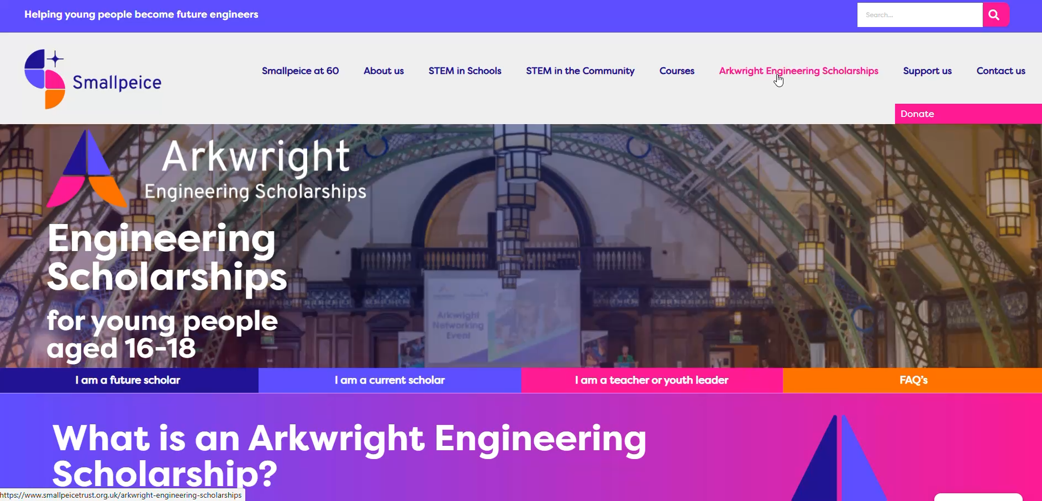
Website Resources

Slide 33

Arkwright Application Club Webinars
Five 30-minute webinars throughout September-November breaking down the application form into manageable sections
Tasks to complete after each session

Slide 34
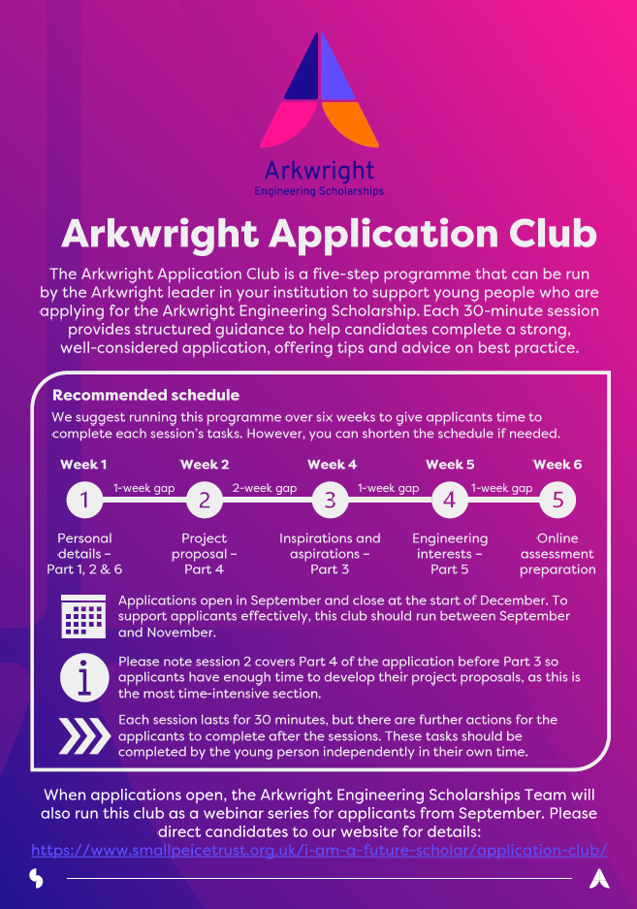
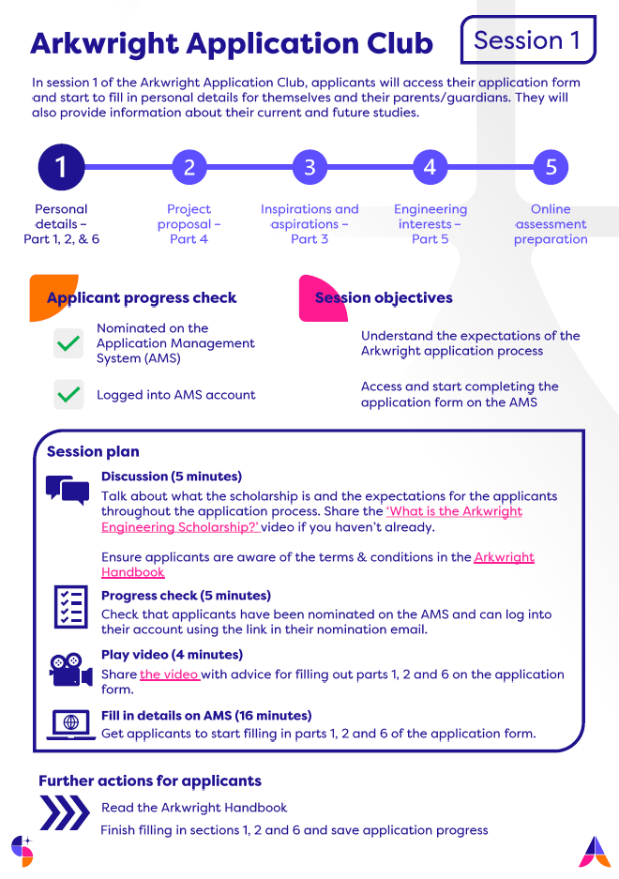
Run an Arkwright Application Club
For nominating adults
Request resources on our website

Slide 35
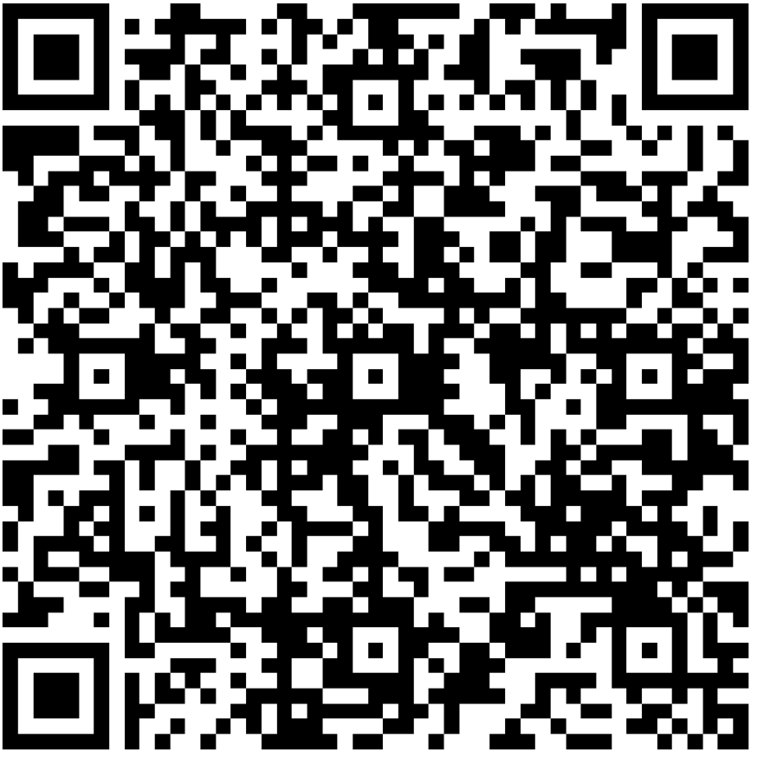
Please feedback via this QR:

